Slide 1
UNIT V
Dividend Theory

Slide 2
Outcome
Analyze the concept of MM hypothesis in light of dividend theory of irrelevance.

Slide 3
Dividend Irrelevance: The Miller–Modigliani (MM) Hypothesis
According to M-M, under a perfect market situation, the dividend policy of a firm is irrelevant as it does not affect the value of the firm. They argue that the value of the firm depends on firm earnings which results from its investment policy. Thus when investment decision of the firm is given, dividend decision the split of earnings between dividends and retained earnings is of no significance in determining the value of the firm. is of no significance.

Slide 4
Contd…..
A firm operating in perfect capital market conditions, may face one of the following three situations regarding the payment of dividends:
The firm has sufficient cash to pay dividends.
The firm does not have sufficient cash to pay dividends, and therefore, it issues new shares to finance the payment of dividends.
The firm does not pay dividends, but shareholders need cash.

Slide 5
MCQ
Which of the following statements is consistent with dividend irrelevance theory?
Investment decisions are the sole determinant of shareholder wealth
b) Making homemade dividends causes investors to incur transaction costs
c) Companies with stable dividend policies build up shareholder clienteles
d) Investors like to maintain the real value of their dividend payments.

Slide 6
Answer
A. Investment decisions are the sole determinant of shareholder wealth

Slide 7
Illustration
The Himgir co.Ltd. Currently has 2 crore outstanding shares selling at a market price of ₹100 per share. The firm has no borrowing. It has internal funds available to make a Capex of ₹30 crore. The Capex is expected to yield a positive net present value of ₹20 crore. The form also wants to pay a dividend per share of ₹15. Given the firm’s Capex plan and its policy of zero borrowing, the firm will have to issue new shares to finance payment of dividends to its shareholders. How will the firm’s value be affected
If it does not pay any dividend
If it pays dividend per share ₹15.

Slide 8
Solution
Firm’s current value = 2*100 = ₹200 crore
After Capex value increase = ₹200+ ₹20 = ₹220 crore
If the firm does not pay any dividend, the value per share = ₹200/2 = ₹110.
If the firm pays a dividend of ₹15 per share, it will entirely utilize its internal funds (15*2= ₹ 30 crore), and it will have to raise ₹30 crore by issuing new shares to undertake Capex.
The value of a share after paying dividend= ₹110- ₹15= ₹95
Thus the existing shareholders get a cash of ₹15/share in the form of dividends, but incur a capital loss of ₹15 in the form of reduced share value. They neither gain nor lose.
The firm will have to issue = ₹30 crore/ ₹95 = ₹31,57,895 (about 31.6 lakh) share to raise ₹30 crore.
Thus the firm now has 2.316 crore shares at ₹95 each share. (2.316*95 = ₹220 crore).

Slide 9
MCQ
Modigliani and Miller argue that the dividend decision __________.
is irrelevant as the value of the firm is based on the earning power of its assets
b. is relevant as the value of the firm is not based just on the earning power of its assets
c. is irrelevant as dividends represent cash leaving the firm to shareholders, who own the firm anyway
d. is relevant as cash outflow always influences other firm decisions

Slide 10
Answer
A. is irrelevant as the value of the firm is based on the earning power of its assets

Slide 11
Assumptions of MM Hypothesis
MM hypothesis of irrelevance is based on the following assumptions:-
Perfect capital markets
The firm operates in perfect capital markets where investors behave rationally, information is freely available to all, and transactions and flotation costs do not exist. Perfect capital markets also imply that no investor is large enough to affect the market price of a share.

Slide 12
Contd….
No taxes
Taxes do not exist; or there are no differences in the tax rates applicable to capital gains and dividends. This means that investors value a rupee of dividend as much as a rupee of capital gains.
Investment policy
The firm has a fixed investment policy.
No risk
Risk of uncertainty does not exist. That is, investors are able to forecast future prices and dividends with certainty, and one discount rate is appropriate for all securities and all time periods.

Slide 13
MCQ
Which of the following is the assumption of the MM model on dividend policy?
A. The firm is an all-equity firm
B. The investments of the firm are financed solely by retained earnings
C. Transactions and flotation costs do not exist
D. None of the above

Slide 14
Answer
C. Transactions and flotation costs do not exist

Slide 15
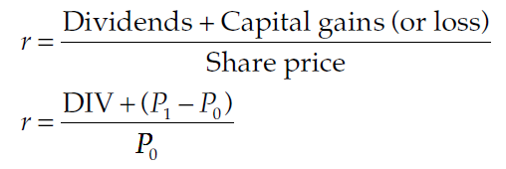
Contd…..
Under the MM assumptions, r will be equal to the discount rate, k, and identical for all shares. As a result, the price of each share must adjust so that the rate of return, which is composed of the rate of dividends and capital gains, on every share will be equal to the discount rate and be identical for all shares. Thus, the rate of return for a share held for one year may be calculated as follows:

Slide 16
Contd….
As hypothesized by MM, r should be equal for all shares. If it is not so, the low-return yielding shares will be sold by investors who will purchase the high-return yielding shares. This process will tend to reduce the price of the low return shares and increase the prices of the high-return shares. This switching or arbitrage will continue until the differentials in rates of return are eliminated. The discount rate will also be equal for all firms under the MM assumptions since there are no risk differences.

Slide 17
MCQ
According to the M.M. hypothesis, the crux of the matter is the “arbitrage process” which of the following statement is incorrect.
It also refers to the simultaneous movement of two transactions which exactly offset each other.
Two transactions involved are paying dividends and raising capital through external funds either through the sale of new shares or raising additional funds through loans to finance investment programs.
If dividends are distributed, an amount will have to be raised through the sale of new shares. The increased value per share through dividends will not offset by the external raising of shares.
None of the above

Slide 18
Answer
C. If dividends are distributed, an amount will have to be raised through the sale of new shares. The increased value per share through dividends will not offset by the external raising of shares.

Slide 19
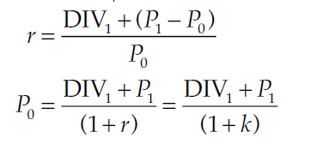

Contd….
From MM’s fundamental principle of valuation model described as follows:
since r = k in the assumed world of certainty and perfect markets. Multiplying both sides of above Equation by the number of shares outstanding, n, we obtain the total value of the firm if no new financing exists:

Slide 20
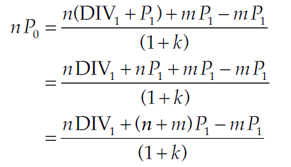

Contd…..
If the firm sells m number of new shares at time 1 at a price of P1, the value of the firm at time 0 will be:
The investment programmes of a firm, in a given period of time, can be financed either by retained earnings or the issue of new shares both. Thus the firm amount of new shares issued will be:

Slide 21
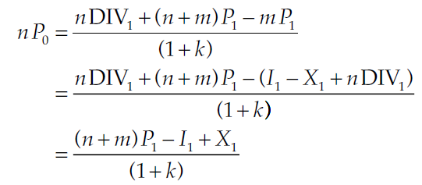
Contd……
where l1 represents the total amount of investment during the first period and X1 is the total net profit of the firm during the first period. By substituting value pf mp1 in previous eq, MM showed that the value of the firm is unaffected by its dividend policy. Thus,

Slide 22
MCQ
Modigliani and Miller argue that the dividend decision __________.
is irrelevant as the value of the firm is based on the earning power of its assets
is relevant as the value of the firm is not based just on the earning power of its assets
is irrelevant as dividends represent cash leaving the firm to shareholders, who own the firm anyway
is relevant as cash outflow always influences other firm decisions

Slide 23
Answer
A. is irrelevant as the value of the firm is based on the earning power of its assets

